Slide 1
SEMISTER PROJECT
RESTAURANT MANAGEMENT SYSTEM
USING PYTHON

Slide 2
DONE BY
PRITAM KUMAR SINGH(17CSE064)
SUMIT PATNAIK(17CSE064)

Slide 3
ABSTRACT
The businesses in restaurants are now growing constantly. At the same time, the need for managing its operations and tasks arises. The best way to optimize these activities is growing the business online as well. Today’s generation encourages high-tech services especially over the Internet.
The project “Restaurant Management System” is implemented to reduce the manual work and enhances the accuracy of work in a restaurant.
RESTAURANT MANAGEMENT SYSTEM is Desktop Application to restaurant management. Hence the project is developed proficiently to help restaurant. This system wake to provide service facility to restaurant and owners automate their BILLING OPERATIONS.
This system entirely reduces the unnecessary time waste inside the hotel as well as it reduces unnecessary calculation.
As per the new rule Goods and Service Tax (GST) levy on both AC and non-AC restaurants to 5%. Every restaurant charges 5% GST breakup as 2.5% State GST (SGST) and 2.5 % Central GST (CGST) without any other service tax and any other VAT charges.. We have developed a RESTAURANT MANAGEMENT SYSTEM with inbuilt GST calculation in the bill, as well as it shows the amount in rupees how much GST is applied.
RESTAURANT MANAGEMENT SYSTEM project fully developed in python language which is currently demanded in market using python GUI Tkinter. Python is a programming language that lets you work quickly and integrate systems more efficiently.

Slide 5
Python Language Introduction
`
Python is a widely used general-purpose, high level programming language. It was initially designed by Guido van Rossum in 1991 and developed by Python Software Foundation. It was mainly developed for emphasis on code readability, and its syntax allows programmers to express concepts in fewer lines of code.
Python is a programming language that lets you work quickly and integrate systems more efficiently.
Python is a high-level, interpreted, interactive and object-oriented scripting language. Python is designed to be highly readable. It uses English keywords frequently where as other languages use punctuation, and it has fewer syntactical constructions than other languages.

Slide 6
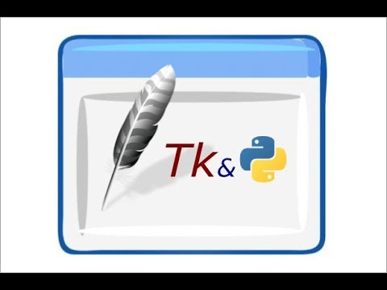
Python graphical user interfaces (GUIs)
Tkinter − Tkinter is the Python interface to the Tk GUI toolkit shipped with Python. We would look this option in this chapter.
wxPython − This is an open-source Python interface for wxWindows http://wxpython.org.
JPython − JPython is a Python port for Java which gives Python scripts seamless access to Java class libraries on the local machine http://www.jython.org.
There are many other interfaces available, which you can find them on the net.

Slide 7
Geometry Management
:
All Tkinter widgets have access to specific geometry management methods, which have the purpose of organizing widgets throughout the parent widget area. Tkinter exposes the following geometry manager classes: pack, grid, and place.
The pack() Method − This geometry manager organizes widgets in blocks before placing them in the parent widget.
The grid() Method − This geometry manager organizes widgets in a table-like structure in the parent widget.
The place() Method − This geometry manager organizes widgets by placing them in a specific position in the parent widget.

Slide 8
SCREENSHOTS
GUI – Main display window with name of restaurant name current time and date with calculator

Slide 9
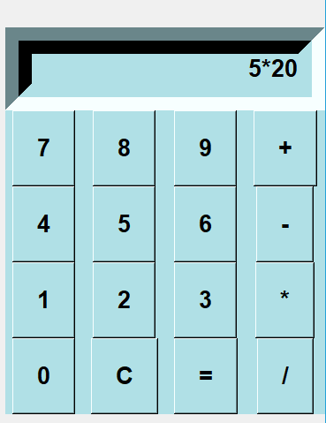
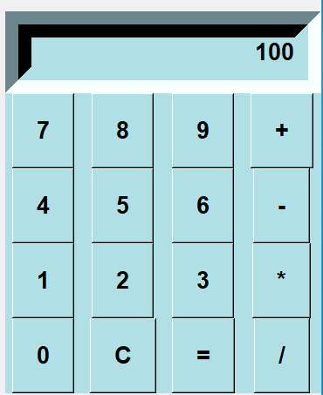
We have added a calculator for instant calculation –

Slide 10
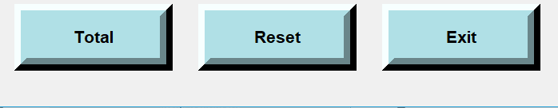
Buttons –

Slide 11
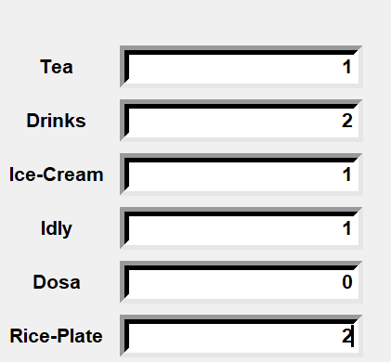
We need to insert number of menu items taken by customer ,after inserting no. of items

Slide 12
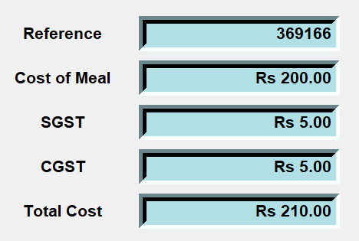
Generated Bill

Slide 13
After clicking TOTAL button it will automatically generate the bill

Slide 14
THANK YOU

